Slide 1



Pipelining In Computer Architecture
Presented By: Muhammad Saad Khan & Umer Bin Ijaz

Slide 2

01
Introduction to Pipelining
02
Execution in a pipelined processor
CONTENT
03
Performance of Pipelined processor
04
Pipeline Conflicts

Slide 3
Introduction to Pipelining
We are able to improve the performance of CPU with the help of two ways, which are described as follows:
We can introduce a faster circuit to improve the hardware.
We can perform more than one operation at once with the help of arranging the hardware.
Since there is a high cost of the faster circuit, and the speed of hardware is also limited. Because of these drawbacks, the 2nd option is good for us.

Slide 4
Introduction to Pipelining
Pipelining:
Pipelining can be described as a technique in which multiple instructions are overlapped at the time of execution. There are five stages in the pipeline, and all these stages are connected with each other so that they can form a pipe-like structure.

Slide 5
Design of a basic Pipeline:
A pipeline basically contains two ends: the first one is an input end, and the second one is an output end. In a pipelined processor, there are a lot of stages/segments between these ends. Here, a specific operation is performed by each stage, and one stage is connected with the input of next stage.
The intermediate output between two stages can be held with the help of an interface register, which is also known as the buffer or latch.
A common clock is used to connect the interface register with all the stages in a pipeline.

Slide 6
Design of a basic Pipeline:
The data is contained with the help of a register, and operations on that data are performed with the help of this combinational circuit. The result of a combinational circuit will be applied to the input register of next segment.
Clock
S1
R1
S2
R2
S3
R3
In the process of pipelining, the hardware elements of CPU will be arranged in a way that the overall performance can be increased. In the process of a pipeline, more than one instruction can be executed simultaneously.

Slide 7
Difference between Pipeline and Non Pipeline
Here, we will learn the concept of pipeline operation with the help of a real-life example. In this example, we will assume a water bottle packaging plant. The bottle has to go through three stages. The first stage is Inserting the bottle (I). The second stage is Filling water in the bottle (F). The third stage is Sealing the bottle (S). Now we will call these stages as stage 1, stage 2, and stage 3 to easily understand this example. We will assume that the operation of each stage is completed in 1 minute.

Slide 8
Average Time in Non Pipeline
Suppose we have a non-pipeline operation. Here in the first stage, the bottle is first inserted into the plant. After 1 minute of insertion, the bottle will go to stage 2, where water is filled into it. At this time, nothing happens in stage 1. Same as when the bottle goes to stage 3, in this case, stage 2 and stage 3 are idle. Hence, to manufacture 1 bottle in non-pipeline operation, the average time is:
Without Pipelining: 9/3 minutes = 3m
I F S | | | | | |
| | | I F S | | |
| | | | | | I F S (9 minutes)

Slide 9
Average Time in Pipeline
Now suppose we have a pipeline operation. Here when a bottle is in stage 2, at the same time, we can load another bottle into stage 1. Same as, when the bottle is in stage 3, at that time, stage 1 and stage 2 each can have one bottle. So at the end of stage 3, we will get a new bottle after each minute. Hence, to manufacture 1 bottle in a pipeline operation, the average time is:
With Pipelining = 5/3 minutes = 1.67m
I F S | |
| I F S |
| | I F S (5 minutes)

Slide 10
Pipelined Stages
In the RISC processor, we can execute all the instructions of RISC instruction set with the help of 5 instructions stages.
The first stage is instruction fetch, where the instruction is fetched from memory.
The second stage is instruction decodes, where instruction is decoded.
The third stage is the instruction execution, where we calculate the address or execute the operation.
The fourth stage is the memory access stage, where memory operands are accessed.
The fifth stage is the write back stage, where the result writes back to the register.

Slide 11

Performance of Pipelined processor
Time taken to execute ‘n’ instructions in a pipelined processor
$${ET}_{pipeline}=\left(k+\left(n−1\right)\right)T_{p}$$
In the same case, for a non-pipelined processor, the execution time of ‘n’ instructions will be:
$${ET}_{non−pipeline}=n×k ×T_{p}$$
Where k = No of stages
N = Insturctions

Slide 12
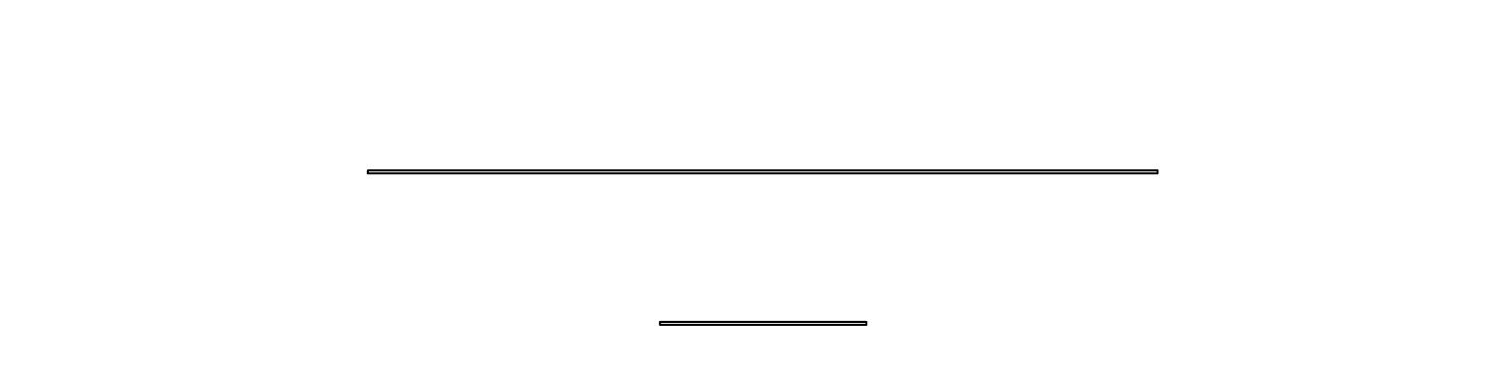
Speedup (S) of the pipelined processor over the non-pipelined processor
So, speedup (S) of the pipelined processor over the non-pipelined processor
$$S= \frac{Performance of non−pipelined processor}{Performance of pipelined processor}$$
$$S= \frac{k ×n}{k+\left(n−1\right)}$$

Slide 13
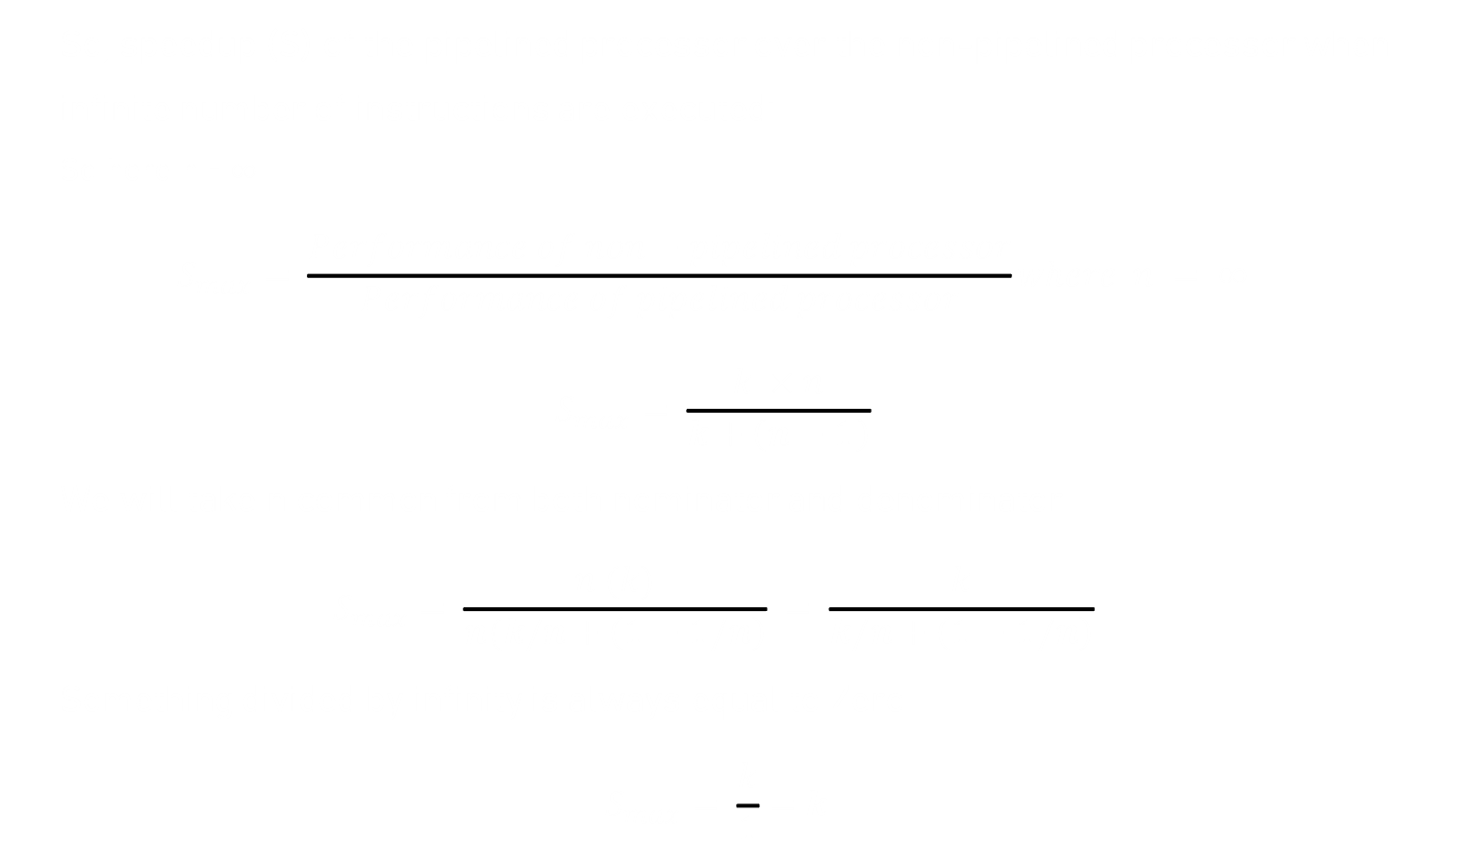
Maximum Speedup (S) of the pipelined processor over the non-pipelined processor
So, speedup (S) of the pipelined processor over the non-pipelined processor when infinite number of instructions are executed:
So here n = $∞$
$$S_{max}= \frac{Performance of non−pipelined processor}{Performance of pipelined processor}where n = ∞$$
$$S_{max}= \frac{k ×n}{k+\left(n−1\right)}$$
We will take n common from both nominator and denominator
$$S_{max}= \frac{n (k)}{n(k/n+\left(1−1/n\right)} = \frac{k}{k/n+\left(1−1/n\right)}$$
Something divided by infinity is always equal to Zero
$$S_{max}= \frac{k}{1}=k$$

Slide 14

Efficiency and Throughput of Pipeline
$$Efficiency = \frac{Current Speed Up}{Max Speed Up} =\frac{S}{S_{max}}=\frac{S}{k}$$
Throughput:
It measure number of instruction completed per unit time.
It represents overall processing speed of pipeline.
Higher throughput indicate processing speed of pipeline.
It can be affected by pipeline length, clock frequency. efficiency of instruction execution and presence of pipeline hazards or stalls
$$\text{Throughput}= \frac{No of Imstruction executed}{Execution Time} =\frac{n}{ \left[k+\left(n−1\right)\right] T_{p}}$$

Slide 15

Latency of Pipeline
Latency:
It measure time taken for a single instruction to complete its execution.
Lower latency indicates better performance .
It in influenced by pipeline length, depth, clock cycle time, instruction dependencies and pipeline hazards.
$$\text{Latency} = \frac{Execution Time}{No of Imstruction executed} = \frac{\left[k+\left(n−1\right)\right] T_{p}}{n}$$

Slide 16
Hazards and Types of Hazards in Pipelining
As our target in pipelining is to get CPI=1. But there are some problems with pipelining due to which CPI target does not achieved. These problems are called Hazards. Hazard leads towards delay due to which we cannot get CPI=1.
The three different types of hazards in computer architecture are:
Data Hazards:
Control Hazards:
Memory Hazards:

Slide 17
Data hazards
Data hazards happen when one instruction relies on a data value that hasn't been made yet because the previous instruction is still being processed.
Data hazards are further into three types
Read After Write (RAW) a true dependency:
Write After Read (WAR) an anti-dependency:
Write After Write (WAW) an output dependency:

Slide 18
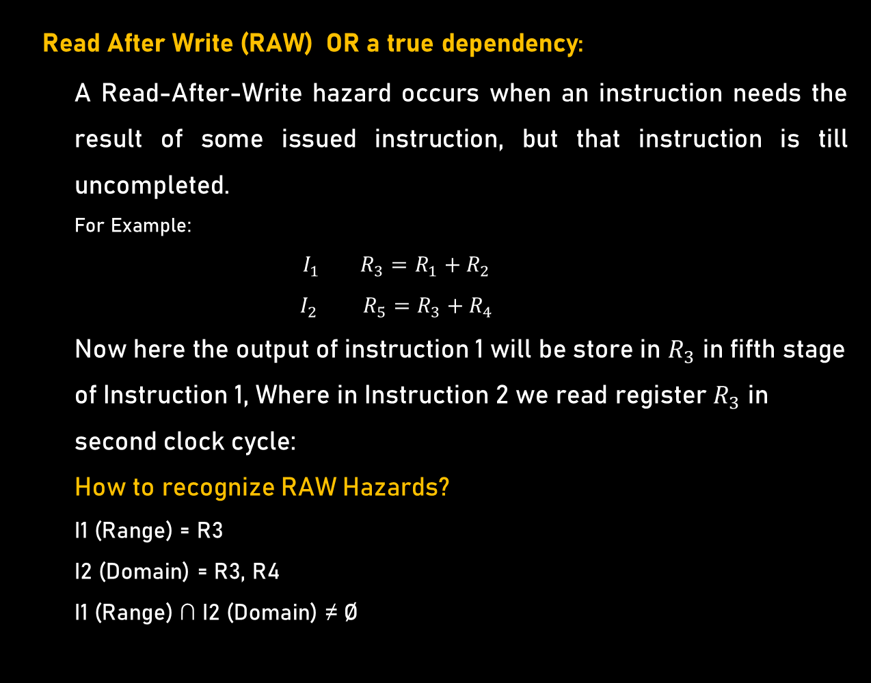


Data hazards
Read After Write (RAW) OR a true dependency:
A Read-After-Write hazard occurs when an instruction needs the result of some issued instruction, but that instruction is till uncompleted.
For Example:
$$I_{1} R_{3}=R_{1}+R_{2}$$
$${I_{2} R}_{5}=R_{3}+R_{4}$$
Now here the output of instruction 1 will be store in $R_{3}$ in fifth stage of Instruction 1, Where in Instruction 2 we read register $R_{3}$ in second clock cycle:
How to recognize RAW Hazards?
I1 (Range) = R3
I2 (Domain) = R3, R4
I1 (Range) ∩ I2 (Domain) ≠ Ø
$$I_{1}$$
Fe
De
Ex
My
Wb
$$I_{2}$$
Fe
De
Ex
My
Wb

Slide 19
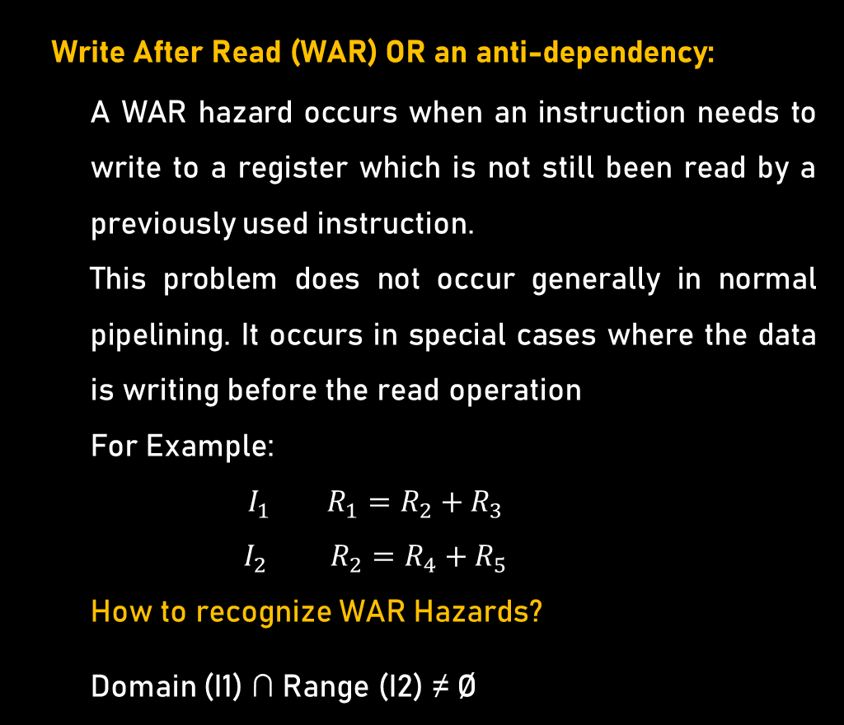
Data hazards
Write After Read (WAR) OR an anti-dependency:
A WAR hazard occurs when an instruction needs to write to a register which is not still been read by a previously used instruction.
This problem does not occur generally in normal pipelining. It occurs in special cases where the data is writing before the read operation
For Example:
$$I_{1} R_{1}=R_{2}+R_{3}$$
$${I_{2} R}_{2}=R_{4}+R_{5}$$
How to recognize WAR Hazards?
Domain (I1) ∩ Range (I2) ≠ Ø
$$I_{1}$$
Fe
De
Ex
My
Wb
$$I_{2}$$
Fe
De
Ex
My
Wb

Slide 20
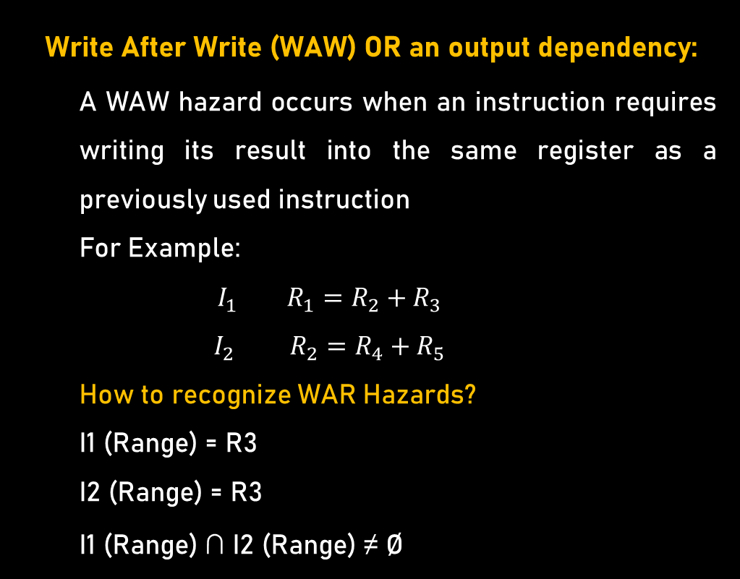
Data hazards
Write After Write (WAW) OR an output dependency:
A WAW hazard occurs when an instruction requires writing its result into the same register as a previously used instruction
For Example:
$$I_{1} R_{1}=R_{2}+R_{3}$$
$${I_{2} R}_{2}=R_{4}+R_{5}$$
How to recognize WAR Hazards?
I1 (Range) = R3
I2 (Range) = R3
I1 (Range) ∩ I2 (Range) ≠ Ø
$$I_{1}$$
Fe
De
Ex
My
Wb
$$I_{2}$$
Fe
De
Ex
My
Wb

Slide 21




Structural hazard
Structural Hazard occurs when multiple instructions need the same resource. For example, the case when multiple instructions are fetching and writing the data to the main memory at a time cause the structural hazard. Resources may be Memory, cache, registers, AlU, Common bus.
For Example:
Suppose there are four instructions which are executing in the pipelining
Conflict miss may be in the following cases
At clock pulse 4, instruction 1 and instruction 4 are using the same resource which is main memory (For memory fetching)
At clock pulse 5, instruction 1 and instruction 4 are using the same resource which is registers (for decoding and write back)
$$I_{1}$$
Fe
De
Ex
My
Wb
$$I_{2}$$
Fe
De
Ex
My
Wb
$$I_{3}$$
Fe
De
Ex
My
Wb
$$I_{4}$$
Fe
De
Ex
My
Wb

Slide 22
Control hazard
Control hazards are Occur Due to branches.
Explanation:
When we fetch the instruction (before to go to decode stage) Program counter is incremented by 1.
At the time of decode stage, we have knowledge about operand (weather it is a Branch or not).
Through the execution stage of on-going instruction, ALU tells us about successful branching or not. Because ALU compares the Branch with zero if it is zero then there will be no Branching if it is not equal to zero then successful branching's occur.
At the time of the write-back of on-going instruction we can change the value of PC to the given address of the branch.
Let suppose the 2nd instruction use branch instruction as in the following diagram.

Slide 23
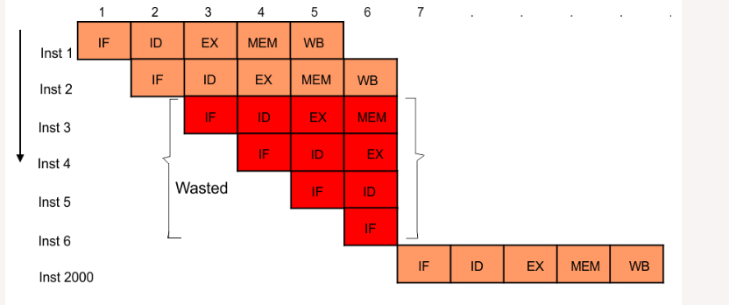
Control hazard
In this way, some stages of instruction 3, 4, 5 are executed in the pipeline but we get the address of the branch in the program counter after 6 clock cycle. So from 7 clock cycle the given address in the branch is executed.
All unsuccessful instruction (3, 4, 5) are flushed. It is problematic for CPI. Performance is decreased. So control Hazard is the most problematic for system performance.
At the time of the 6th clock cycle Program counter get the branch address and from 7th clock cycle given address in the branch is executed.

Slide 24
THE END
Thank You

